Slide 1

Emotions Moods Attitudes
ORGB1500 - Organizational Behaviour for Media and IT - Ed Beerwart

Slide 2

Emotions, Moods, & Attitudes
Content
Emotions Moods Attitudes
Affect
Emotion
Circumplex of Emotions
Stimulus, cognition, and behaviour
Mood
Attitude
Emotional Labour
Emotional Intelligence
Empathy

Slide 3
Emotions, Moods, & Attitudes

Slide 4
Affect
R
U
“
Any experience of feeling or emotion, ranging from suffering to elation, from the simplest to the most complex sensations of feeling, and from the most normal to the most pathological emotional reactions.
”
VandenBos, G. R. (Ed.). (2007). APA Dictionary of Psychology. Washington, DC, US: American Psychological Association.

Slide 5
Emotion
R
U
“
A complex reaction pattern, involving experiential, behavioral, and physiological elements, by which the individuals attempts to deal with a personally significant matter or event. The specific quality of the emotion (e.g., fear, shame) is determined by the specific significance of the event.
”
VandenBos, G. R. (Ed.). (2007). APA Dictionary of Psychology. Washington, DC, US: American Psychological Association.
Emotions are physiological, behavioural, and psychological episodes experienced toward an object, person, or even that create a sense of readiness. These episodes are very brief events that typically last only milliseconds to a few minutes. They occur quicker or before thinking/cognition.
Source: McShane, S. L., & Steen, S. L. (2009). Canadian Organizational Behaviour (7th ed.). McGraw-Hill Ryerson

Slide 6
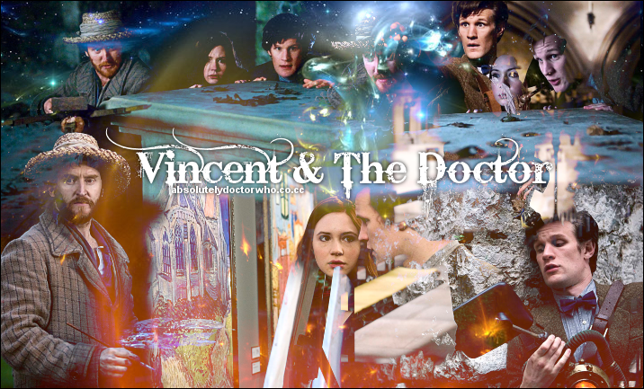
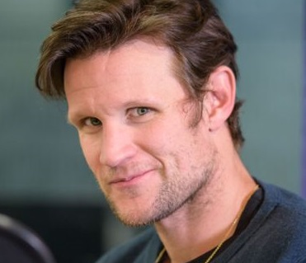
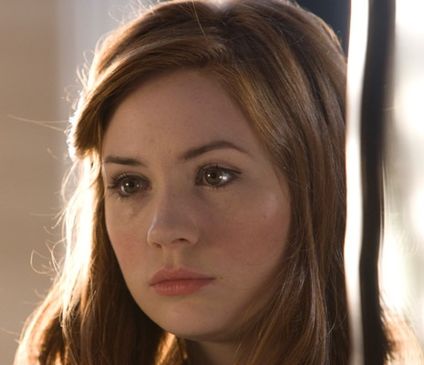
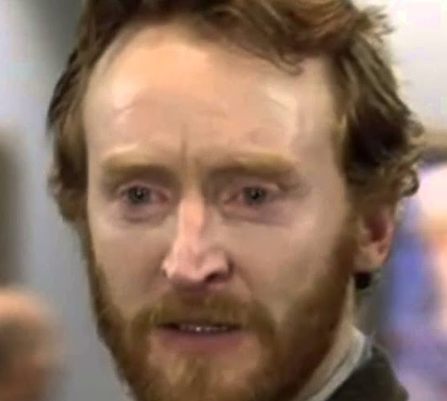
Emotion example
Doctor Who
Season 05 Episode 10
“Vincent and the Doctor”
(46 mins)
The Doctor and Amy travel back in time to meet Vincent Van Gogh and face an invisible monster that only the painter can see.
The
Doctor
Amy
Pond
Vincent Van Gogh

Slide 7
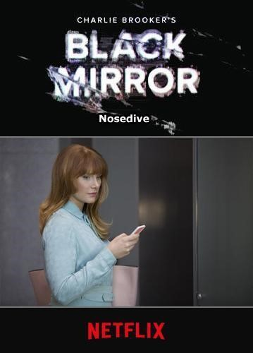
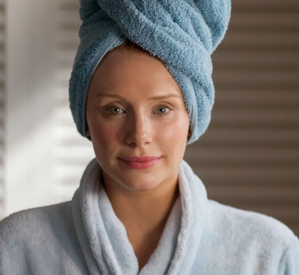
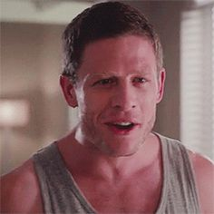
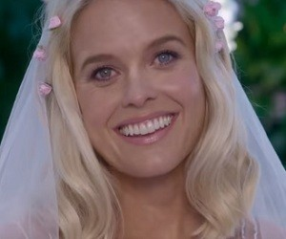
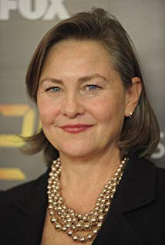
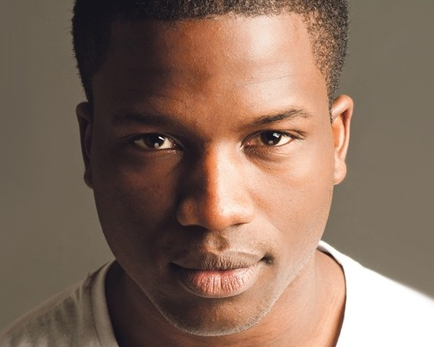
Emotion example
Ap
Black Mirror
Season 3 Episode 1
“Nosedive”
(63 mins)
A woman desperate to boost her social media score hits the jackpot when she's invited to a swanky wedding, but the trip doesn't go as planned.
Lacie
Pound
Ryan
Pound
Naomi
Blestow
Susan
Prisoner

Slide 8
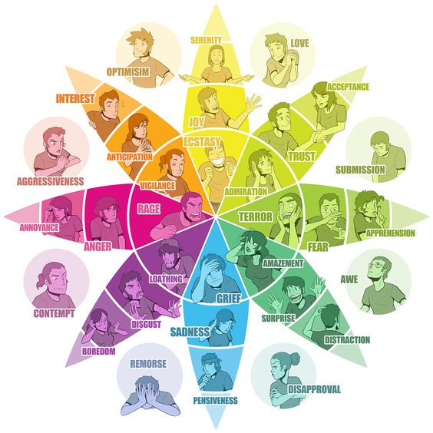
Emotion

Slide 9
Emotion
Ap
An
Analyze the main characters in regards to the emotions demonstrated.
Which emotions do we see from Vincent? Amy? The Doctor? The townspeople?

Slide 10
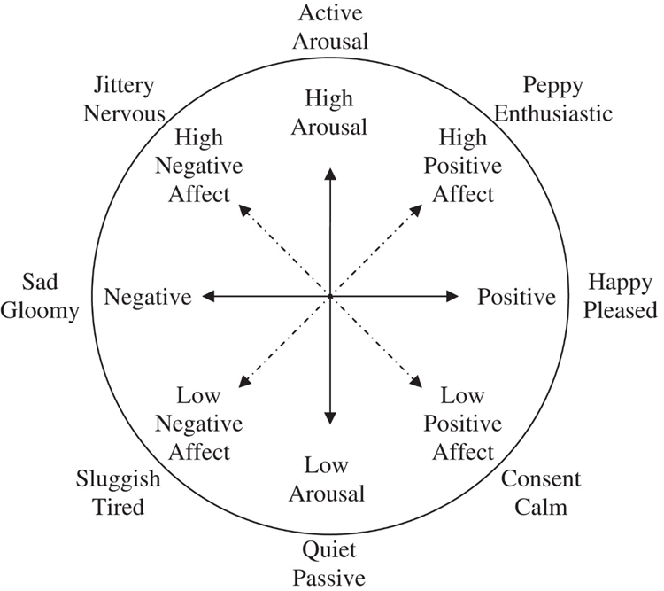
Circumplex of Emotions
Ap
An
Analyze the main characters in regards to the emotions demonstrated.
Which emotions do we see from Vincent? Amy? The Doctor? The townspeople?

Slide 11
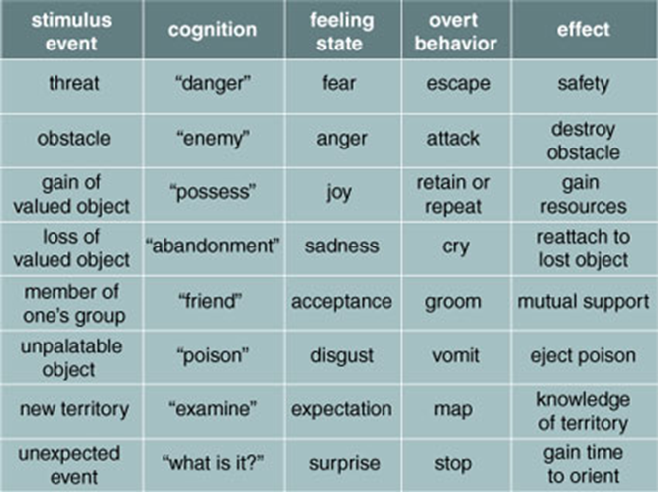
Emotion
Ap
An
Analyze the main characters found in the episode of in regards to the stimulus events, cognition, feeling state (emotion), overt behaviour, and effect.

Slide 12
Moods
R
U
“
Any short-lived emotional state, usually of low intensity (e.g., a cheerful mood, an irritable mood). Also a disposition to respond emotionally in a particular way that may last for hours, days, or even weeks, perhaps at a low level and without the person knowing what prompted the state.
Moods differ from emotions in lacking an object; for example, the emotion of anger can be aroused by an insult, but an angry mood may arise when one does not know what one is angry about or what elicited the anger.
Disturbances in mood are characteristic of mood disorders.
”
VandenBos, G. R. (Ed.). (2007). APA Dictionary of Psychology. Washington, DC, US: American Psychological Association.

Slide 13
Moods
E
Are moods more affected by emotions or are emotions more affected by a person’s moods?

Slide 14
Attitude
R
U
“
In social psychology, a relatively enduring and general evaluation of an object, person, group, issue, or concept on a scale ranging from negative to positive.
”
VandenBos, G. R. (Ed.). (2007). APA Dictionary of Psychology. Washington, DC, US: American Psychological Association.

Slide 15
Attitudes
Ap
An
What are people’s attitudes towards cellphone companies?
Coffee shops?
Gaming publishers?

Slide 16
Emotional Labour
&
Emotional Intelligence

Slide 17
Emotional Labour
R
U
“
The ability of an individual to modulate an emotion or set of emotions.
Techniques of conscious emotional regulation can include learning to construe situations differently in order to manage them better, changing the target of an emotion (e.g., anger) in a way likely to produce a more positive outcome, and recognizing how different behaviours can be used in the service of a given emotional state
”
VandenBos, G. R. (Ed.). (2007). APA Dictionary of Psychology. Washington, DC, US: American Psychological Association.

Slide 18
Emotional Intelligence
R
U
“
A type of intelligence that involves the ability to process emotional information and use it in reasoning and other cognitive activities.
It comprises four abilities: to perceive and appraise emotions accurately; to access and evoke emotions when they facilitate cognition; to comprehend emotional language and make use of emotional information; and to regulate one’s own and others’ emotional to promote growth and well-being.
”
VandenBos, G. R. (Ed.). (2007). APA Dictionary of Psychology. Washington, DC, US: American Psychological Association.

Slide 19
Emotional Labour / Emotional Intelligence
Ap
An
Apply emotional labour, emotional intelligence, and empathy to the characters in the examples we have seen

Slide 20
Empathy
R
U
“
Understanding a person from his or her frame of reference rather than one’s own, so that one vicariously experiences the person’s feelings, perceptions, and thoughts.
Empathy does not, of itself, entail motivation to be of assistance, although it may turn into sympathy or personal distress, which may result in action.
In psychotherapy, therapist empathy for the client can be a path to comprehension of the client’s cognitions, affects, or behaviours.
”
VandenBos, G. R. (Ed.). (2007). APA Dictionary of Psychology. Washington, DC, US: American Psychological Association.

Slide 21

Thank You
ebeerwart@nait.ca

